Slide 1

Detecting Fake News using Deep Learning
Avinash Chandrasekaran

Slide 2
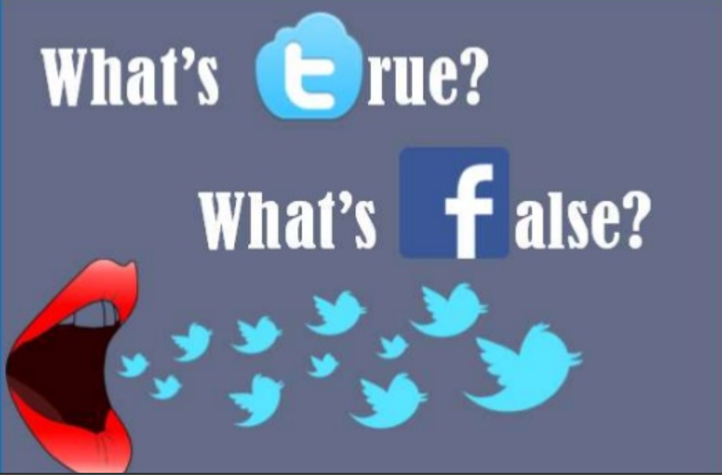
Proliferation of misleading information in everyday media outlets have made it challenging to identify trustworthy news sources
Greater need for computational tools to provide insights into reliability of online content
Paper from researchers at Michigan & Amsterdam focus on automatic identification of fake content in online news
Notes:
Fact- checking
Social network activity (tweets)
Website authencity

Slide 3
Baseline Scores
Two novel datasets covering six different news domain
Sports, business, entertainment, politics, technology, education
Data contains uniform distribution between fake and real news items
50% accuracy with random probability
Model used: Linear SVM classification. Evaluations conducted using five-fold cross validation.
Accuracies of 76% to detect fake news

Slide 4
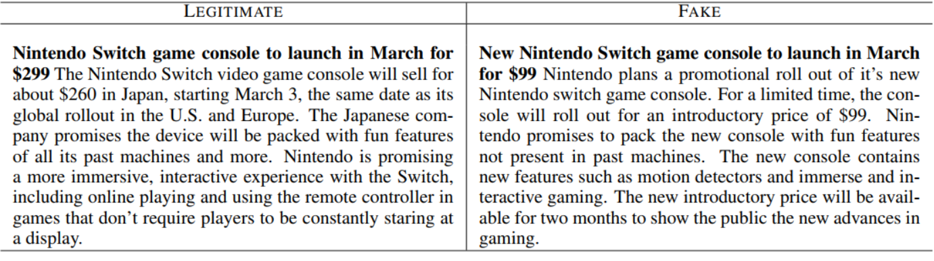
Dataset
Legitimate news obtained from mainstream news websites (NYTimes, Bloomberg, CNET, CNN etc). Manually fact checked
Fake versions crowdsourced via Amazon Mechanical Turk. Instructions provided emulate journalistic style; Submission restricted to US workers and allowed only single submission
Notes:
Celebrity dataset : collect news from web sources to identify fake content that naturally occurs on the web
Sources include online magazines such as Entertainment Weekly, People Magazine
Claims made in the article were evaluated using gossip-checking sites such as ”GossipCop.com”,

Slide 5
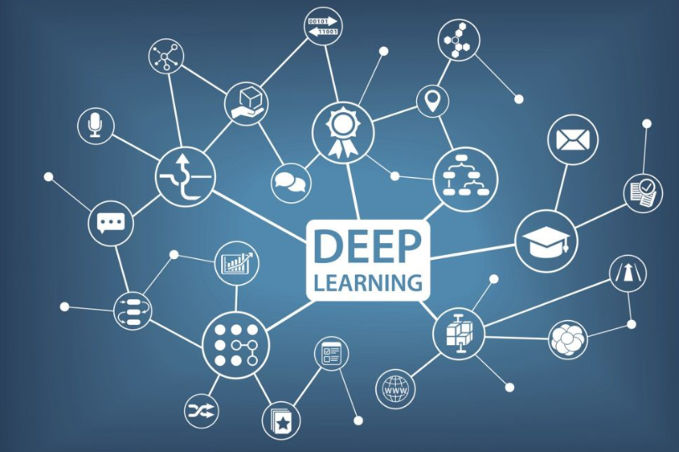
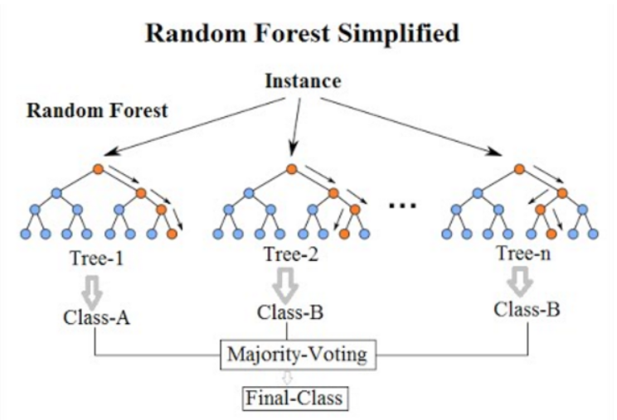
Objective
Exploratory analyses of few deep learning models on word embeddings
LSTM, GRU, BERT Transformer
Extract linguistic features and use machine learning to classify
RandomForest Classifier
Compare results from both approaches to baseline scores

Slide 6
Deep Learning Models
Clean articles: strip special characters, lower case etc
Load GLOVe model & convert to Word2Vec
1-layer and 2-layer LSTM: News has temporal aspect i.e. word used in a sentence depends on words before or after
GRU: Helps alleviate vanishing gradient problem from standard RNNs
BERT Transformer: State of the art!
Model | Accuracy (FakeNews) | Accuracy (Celebrity)
1-LSTM | 55% | 58%
2-LSTM | 55% | 63%
GRU | 54% | 54%
BERT | 65% | 67%
Notes:
RNNs have shown to be one of the most effective algorithms for classifying sequential data, because at each step in a sequence they are able to effectively remember important patterns from previous steps

Slide 7
Linguistic Feature Modelling
N-Gram: Extract uni, bigrams and weight with TF-IDF
Punctuations: Included them as complete words
Readability: Statistics from text to determine complexity, grade of corpus
Syntax: Tagging and replacing with POS
Psycholinguistic: Not used in my project. Authors use analytical thinking, emotional tone etc as added features
Accuracy FakeNews | Accuracy Celebrity
77% | 80%
Notes:
The linguistic approach attempts to identify text properties, such as writing style and content, that can help to discriminate real from fake news articles.
The underlying assumption for this approach is that linguistic behaviors such as punctuation usage, word type choices, part-of-speech tags, and emotional valence of a text are rather involuntary and therefore outside of the author’s control, thus revealing important insights into the nature of the text.

Slide 8
Results & Conclusion
Deep learning is a powerful tool in itself. Feature engineering on top it certainly adds value. Key consideration is target user’s comfort level with subject domain vs. machine learning experience
Consider computational complexity when comparing simple machine learning models to state of art deep learning technology
Result skewed due to small data size
More opportunities for hyper-parameter tuning to improve results
Future: NLP + social context + fact checking algorithms
Notes:
The linguistic approach attempts to identify text properties, such as writing style and content, that can help to discriminate real from fake news articles.
The underlying assumption for this approach is that linguistic behaviors such as punctuation usage, word type choices, part-of-speech tags, and emotional valence of a text are rather involuntary and therefore outside of the author’s control, thus revealing important insights into the nature of the text.

